Slide 1
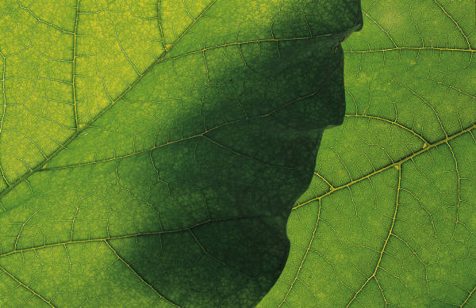


THE TEMPORAL ECOLOGY LAB, HARVARD UNIVERSITY
Suzanne Mrozak, Volunteer Coordinator
Danny Schissler, Intern
Cat Chamberlain, Graduate Student

